Slide 1
Electricity Supply Refurbishment Frequently Asked Questions:

Slide 2
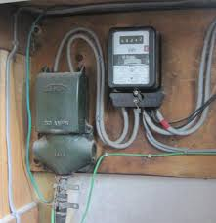
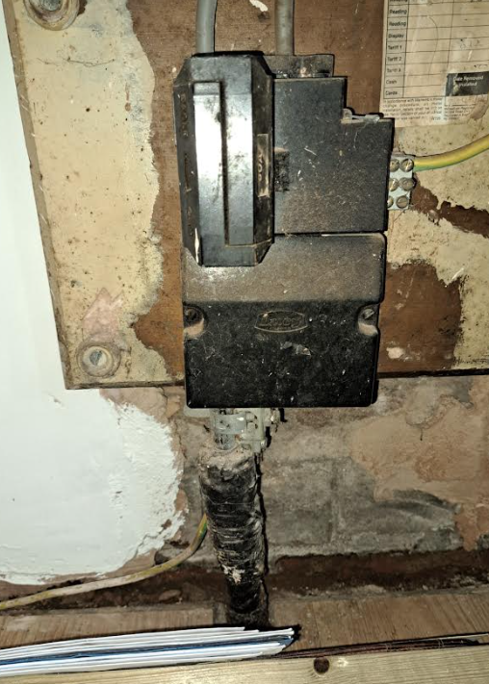
Why are the Electricity Supplies being Upgraded?
Most electricity supplies installed in the last 100 years were based around a much lower demand.
With the uptake of electric cars and the phasing out of Gas boilers as part of the Government's commitment to Net Zero, and the introduction of Electric Heat Pumps the potential demand for electricity has risen above the capability of the current equipment.
Scottish Power have looked at the security of the electricity network and the uptake of Net Zero options and they have identified this area for upgrade works.

Slide 3
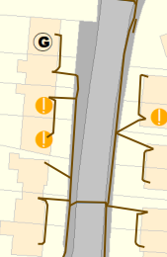
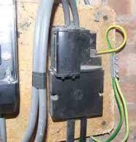
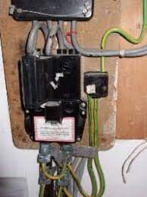
What is a looped supply?
During the original installation of Electricity supplies the demand for each property was assumed to be of such a low value one electricity supply cable could supply 2 or sometimes 3 properties.
These looped supplies now limit your electricity usage, you will not be permitted an EV charger or Heat Pump on a looped supply.

Slide 4
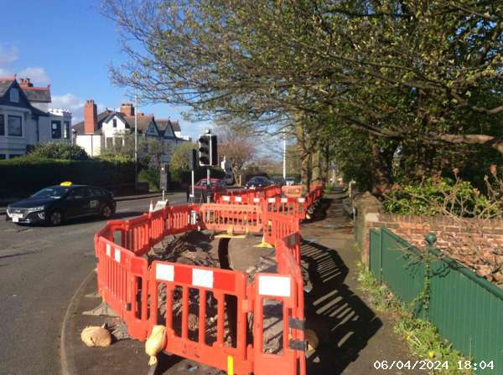
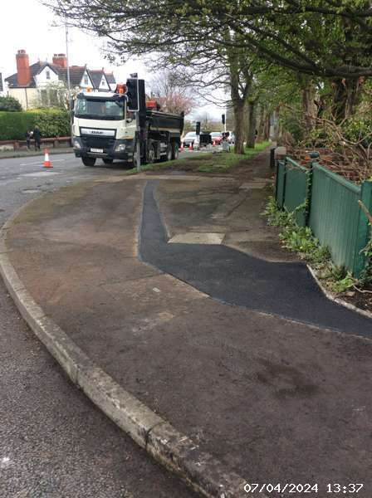
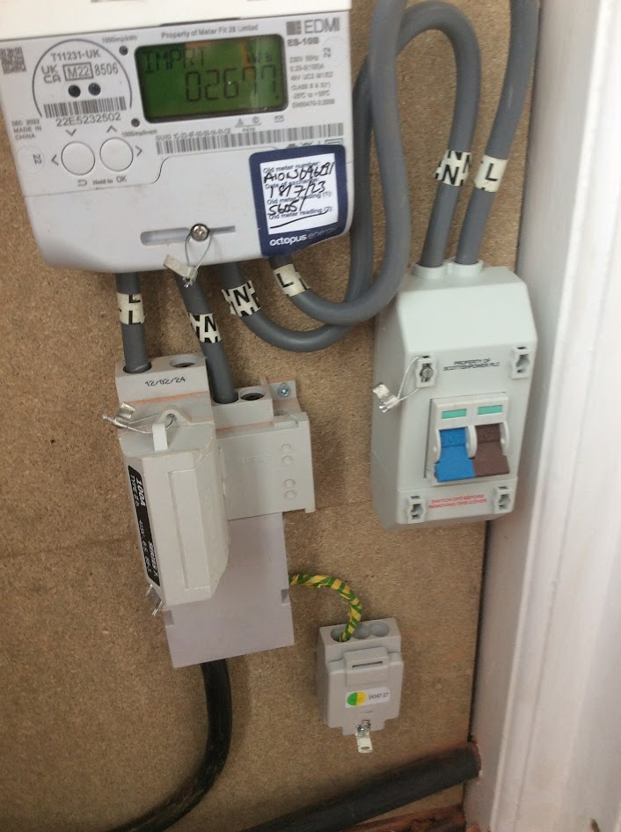
Will it cost me anything?
The upgrades are being offered completely free of charge by Scottish Power as part of their investment to deliver Net Zero electricity supplies.
The only cost to the residents will be some minor inconvenience while we complete our works in the footway, on your property and inside your property.
On the completion of our works the existing electricity network will be disconnected and abandoned so it is important we get your supply changed over.

Slide 5
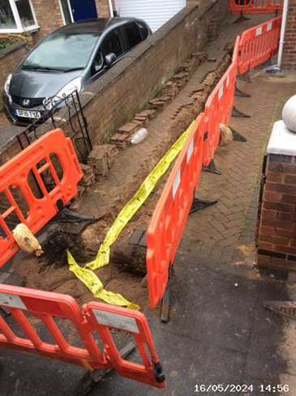
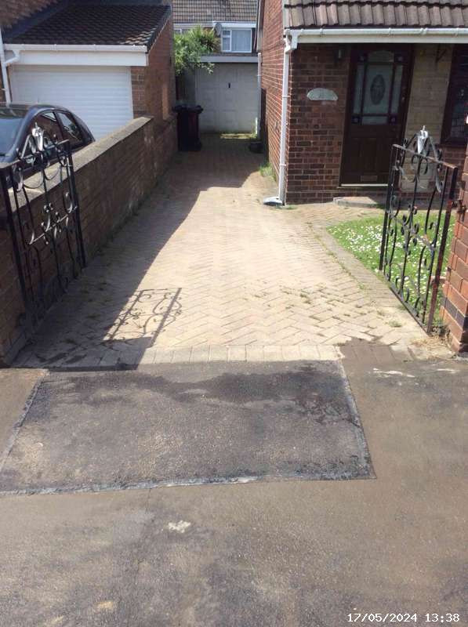
Will there be any mess or disturbance?
Unfortunately we can’t complete these works without excavating in the Roads, footways and properties.
We are vastly experienced in this type of work and will agree all routes of trenches on your property with you and we will reinstate to agreed standards.
We will be closely monitored by the Local Council for works in the Public realm and also by Scottish Power throughout the works.
We work in all weathers so occasionally there may be some mess that we will endeavor to clean up as soon as possible.

Slide 6
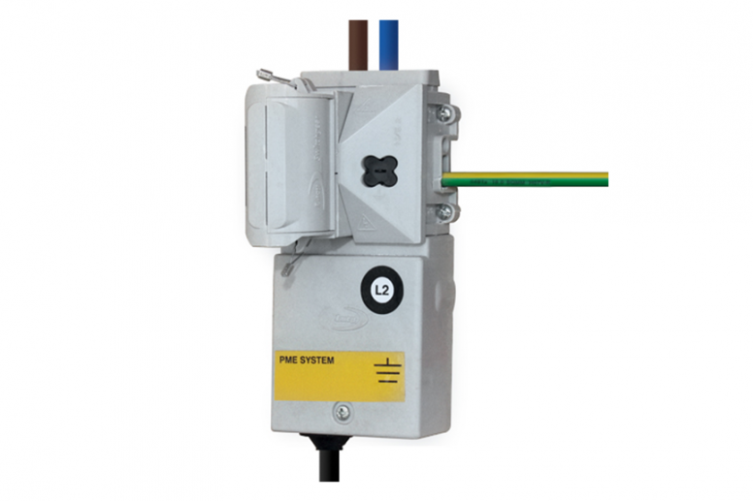
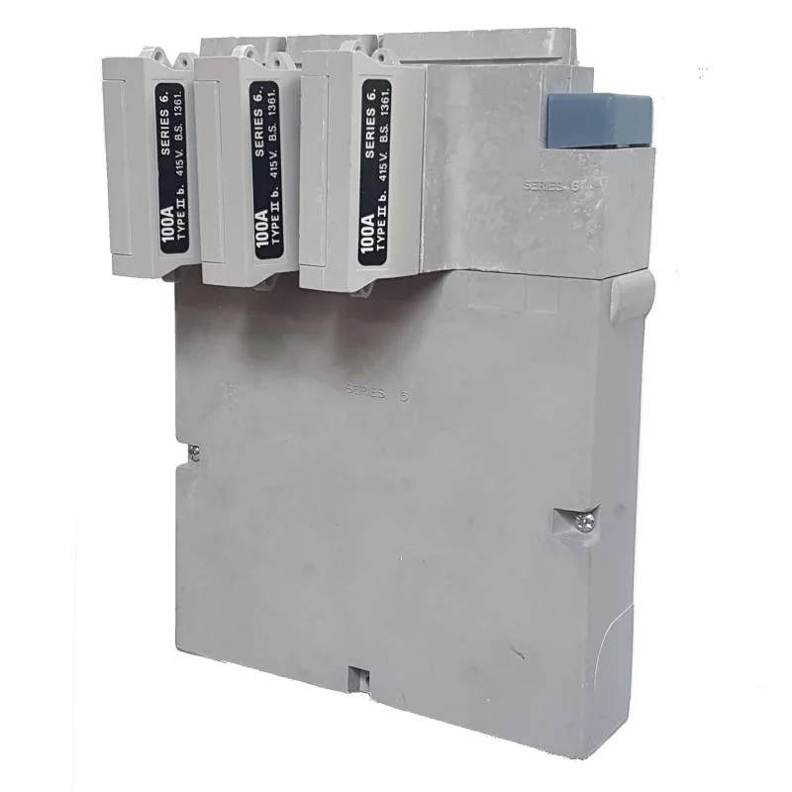
What is Single phase & Three phase?
Single Phase is having a single main fuse rated at 80 amps or less.
This is limiting as the amount of electricity you can use at one time is limited to 80 amps. Most UK properties have this supply.
If you have an Electric Vehicle charger and / or Heat Pump fitted it would have to be a low power version as it would have to share the 80 amps with other electrical items in your house such as a cooker, shower, heaters, lights & sockets etc.
Three Phase has 3 main fuses each rated at 80 amps, this means you can have multiple electrical items all running at once without the fear of overloading the system or being limited.
3 phase electric heat pumps (Gas Boiler replacements for net zero) are far more efficient and effective.
The offer of a 3 phase upgrade free of charge is only available during these network upgrade works, if not taken future requests will be charged at around £2k to £5k

Slide 7
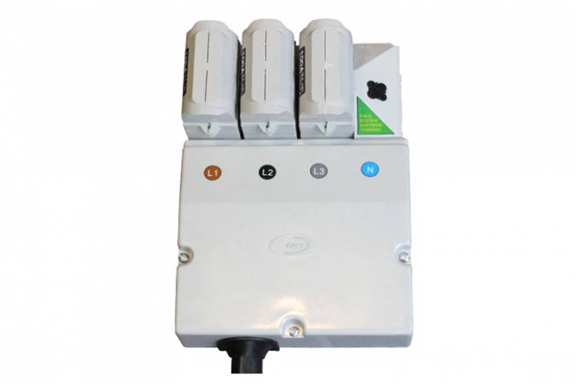
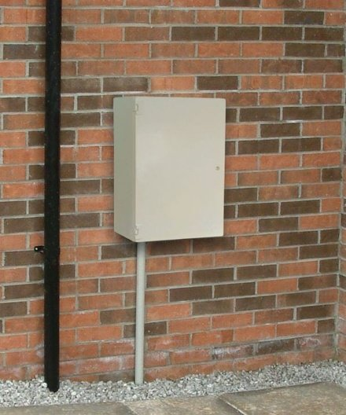
What are the Refurbishment options?
A fully upgraded 3 phase supply inside your home if technically possible.
A fully upgraded 3 phase supply provided in a free of charge cupboard on the outside of your property within 2 mtrs of your electric meter position if technically possible.
A new 3 phase cable routed underground as close to your meter position as possible but your property remains on a limited single phase supply.
(3. nb Future upgrades, if / when required, would be charged at around £2k to £5k if works are technically possible during this refurbishment offer)

Slide 8
I don’t want any works on my property.
The existing Electricity system will be disconnected at the end of the refurbishment / upgrade works and if you have not permitted us access to complete the upgrades then you could be served with a notice of disconnection meaning your supply will go off.
We don’t want to get to this point so we will discuss every option available to keep you on supply and get you connected to the new system.

Slide 9
Will the power go off?
Yes, in most cases the power will need to go off, we may in very special medical circumstances carry out additional works to keep the power on.
We will keep the outage to an absolute minimum and will only turn off the supply when arranged with you.
If you are on the Priority Register please let our representative know.
We will give you written notification of any outages and agree a convenient time to complete the works inside your property.
Fridges, freezers and Computers will be fine if you follow the simple instructions given with the appointment letters

Slide 10
Thank you for your time

